Slide 1
BRIGHT TV Sales pitch
By Gomolemo Moabalobelo

Slide 2
TABLE OF CONTENTS
Introduction 3
User Engagement by Channel and Duration 4
User Age Groups vs. Channel and Duration Preferences 5
User Race: Channel and Duration Preferences 6
User Province: Channel and Duration Preferences 7
User Gender: Channel and Duration Preferences 8
Weekly Consumption Patterns by Channel and Duration 9
Monthly Consumption Patterns by Channel and Duration 10
Hourly Consumption Patterns by Channel and Duration 11
Recommendations 12
Conclusion 13

Slide 3
INTRODUCTION
Bright TV’s CEO has set a goal to grow the company’s subscription base in the current financial year. To achieve this, actionable insights are needed to assist the Customer Value Management (CVM) team in designing targeted strategies. The insights shared on this slide will enable the CVM team to better understand customer behavior, uncover growth opportunities, and take informed actions to increase subscriptions.

Slide 4
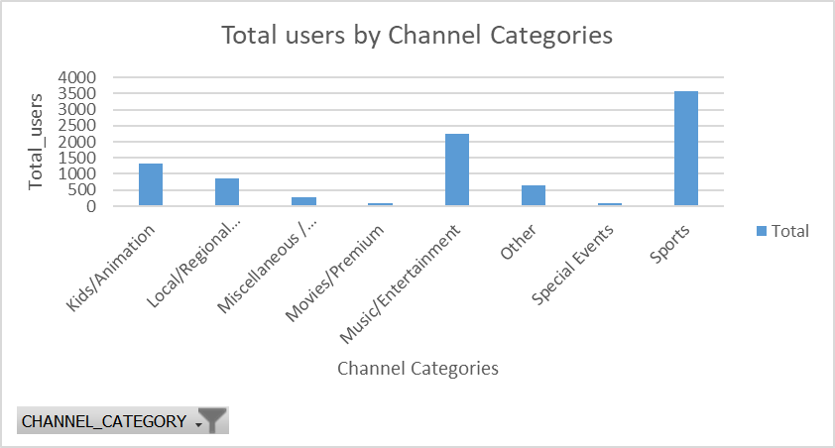
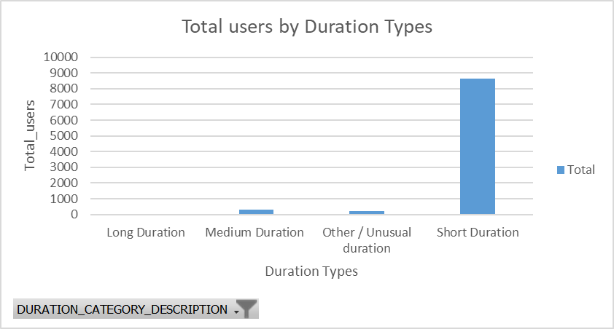
User Engagement by Channel and Duration
The majority of Bright TV users are concentrated in the Sport (3,580 users, 39%) and Music (2,242 users, 24%) channels, making these the primary drivers of subscriptions and engagement.
The Special Events channel has a very small audience (91 users, 1%) and requires targeted campaigns to increase viewership.
The vast majority of Bright TV users (8,637 out of 9,155, 94%) prefer short-duration content, while only a handful of users (5, <1%) engage with long-duration programs.
This indicates that short-form content drives most user engagement.

Slide 5
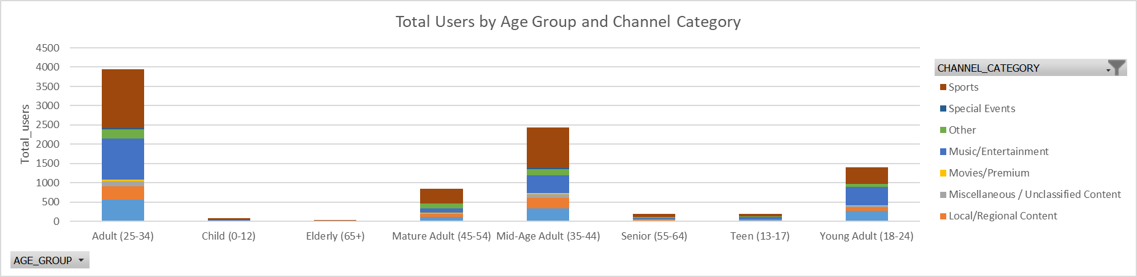
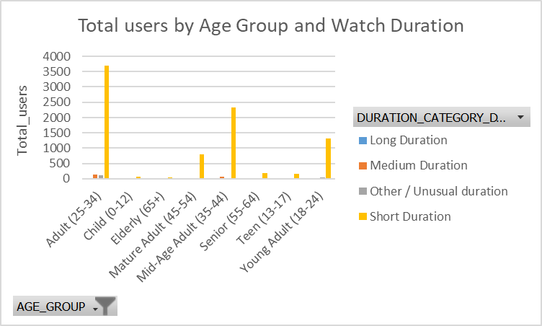
User Age Groups vs. Channel and Duration Preferences
The Sport channel is the most watched across all age groups, with Adults accounting for 1,527 users (~41% of total Sport viewers) and the Elderly contributing only 23 users (<1%).
Movies are the least popular, with Adults at 37 users (~1% of total Movie viewers) and no viewership from the Elderly. Overall, the Adult group generates the majority of views across channels, while the Elderly group shows minimal engagement.
Across all age groups, short-duration content is clearly the most popular, with 3,697 Adults (~40% of total users) and 41 Elderly users (<1%) engaging with it.
In contrast, long-duration content is rarely watched, with only 5 users out of 9,155 (<0.1%) viewing it, emphasizing a strong preference for brief, easily consumable programs.

Slide 6
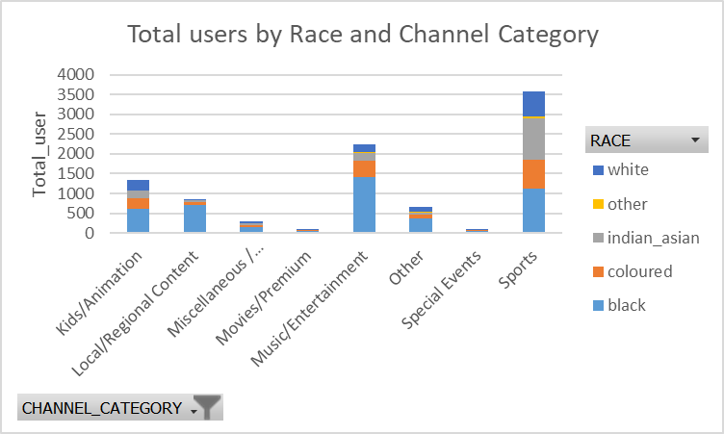
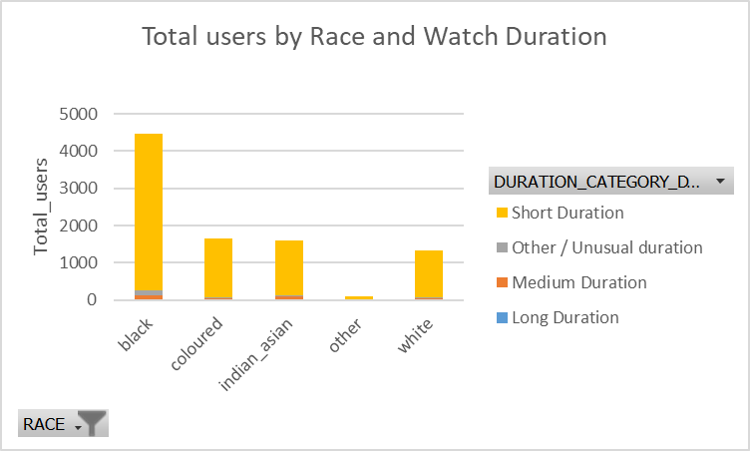
User Race: Channel and Duration Preferences
The Black race has strong engagement on Music, where they account for 63% of all black viewers and on Special Events, making up 55% of black viewers.
In contrast, the Other race group contributes very little, representing only 1% of Music viewers and showing no participation in Movies out of 108 users.
At the channel level, Sport stands out as the most watched channel, attracting 39% of all users ,while Special Events is the least watched, with only 0.1% of users.
Overall, the patterns highlight that Black users drive the majority of viewership, while engagement from other racial groups remains minimal.
Short films are the most preferred across all races, while long films receive almost no engagement.
The Black race dominates overall viewership, with 4,218 out of 4,478 users (~94%) watching short films and no participation in long films.
The Other race shows significantly lower engagement, with 99 out of 108 users (~92%) watching short films and also no views recorded for long films.
This pattern clearly indicates a strong preference for short-form content across all racial groups.

Slide 7
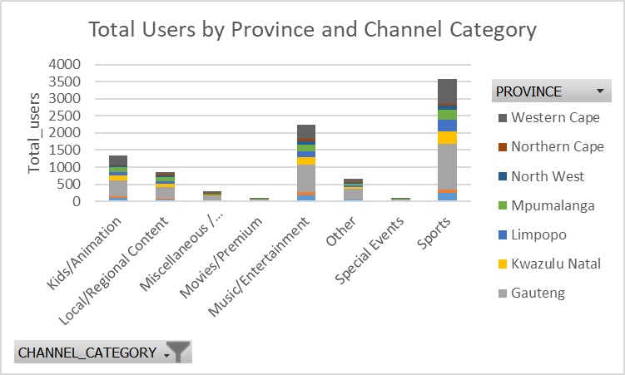
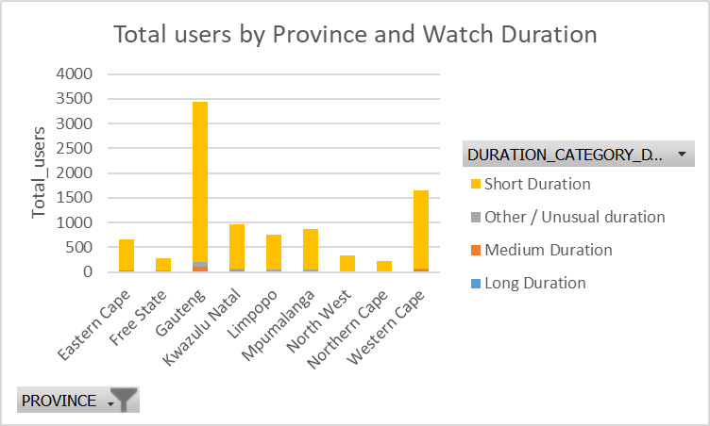
User Province: Channel and Duration Preferences
Sports is the most preferred channel across all provinces, while Special Events receives the least engagement.
Gauteng leads in overall viewership, with 1,344 out of 3,437 users (~39%) watching Sports and only 28 users engaging with Movies.
In contrast, the Northern Cape shows lower overall activity but follows a similar pattern, with 741 out of 1,651 users (~45%) watching Sports and just 15 users viewing Special Events.
This trend highlights the strong dominance of sports content across provinces and the limited appeal of special event programming.
Short films are the most preferred across all provinces, while long films show almost no engagement.
Gauteng leads in overall viewership, with 3,231 out of 3,437 users (~94%) watching short films and only 2 users engaging with long films.
In contrast, the Northern Cape shows much lower overall engagement but follows the same pattern, with 210 out of 220 users (~95%) watching short films and no views recorded for long films.
This trend highlights a strong and consistent preference for short-form content across all provinces.

Slide 8
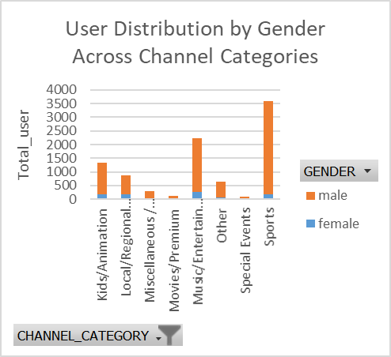
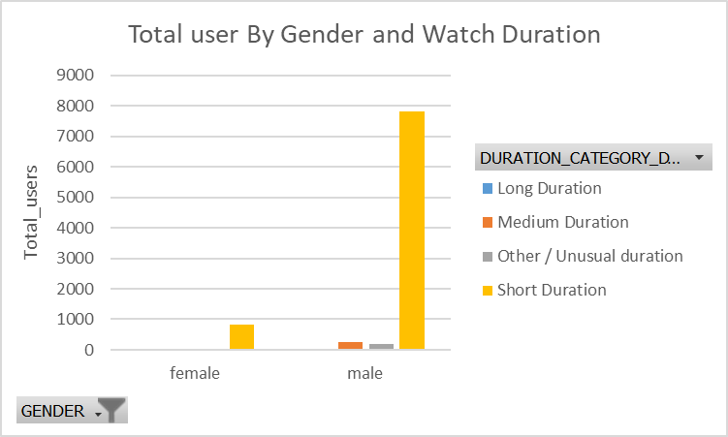
User Gender: Channel and Duration Preferences
Sports is the most preferred channel across all genders, while Special Events receives the least engagement.
Male users dominate overall viewership, with 3,392 out of 8,261 males (~41%) watching Sports and only 78 males engaging with Special Events.
Female users show significantly lower overall engagement, with 257 out of 894 females (~29%) watching Music and just 13 females viewing Special Events.
These patterns highlight that males drive the majority of channel viewership, while Special Events remains the least appealing channel for both genders.
Male users dominate overall viewership, showing significantly higher engagement than females.
Among males, 7,817 out of 8,261 (~95%) watch short films, while only 5 males engage with long films.
Female users follow a similar pattern, with 820 out of 894 (~92%) watching short films and no recorded views for long films.
Overall, short films are the most preferred content across both genders, while long films receive almost no engagement.

Slide 9
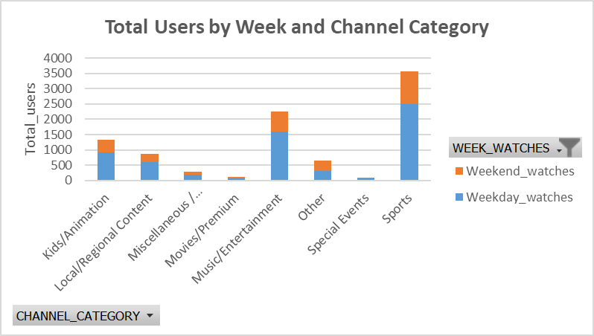
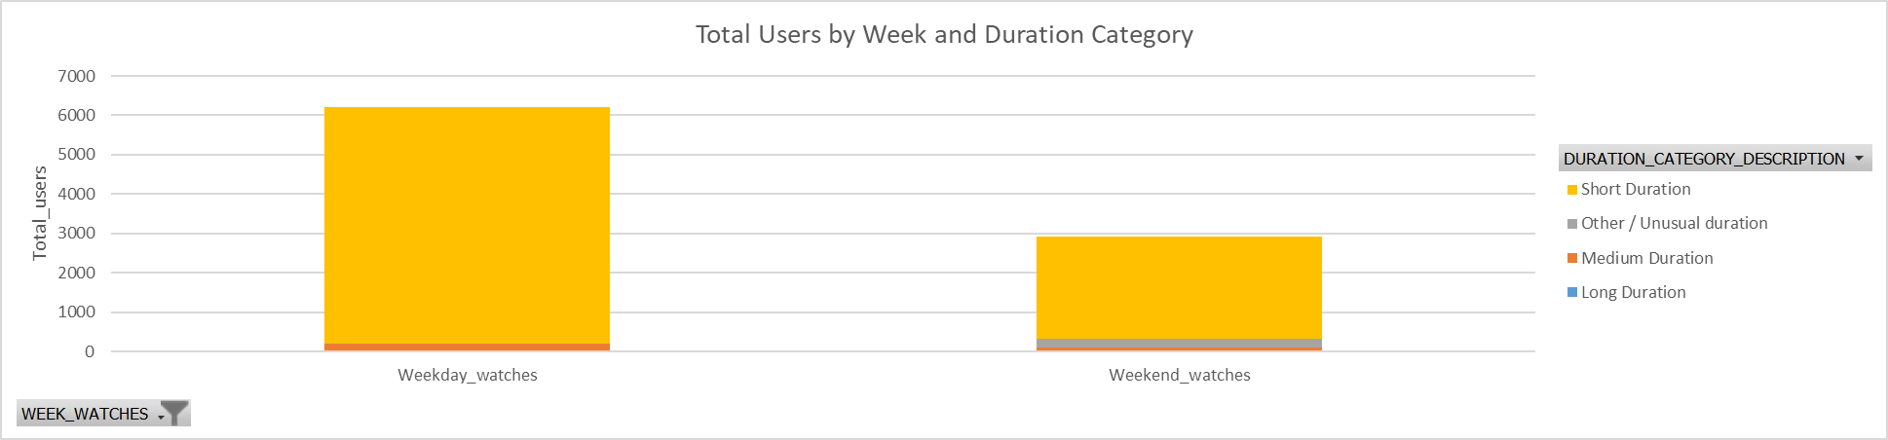
Weekly Consumption Patterns by Channel and Duration
Weekdays consistently record higher viewership than weekends.
On weekdays, 2,498 out of 6,221 users (~40%) watch Sports, while only 61 users engage with Special Events.
During weekends, 1,082 out of 2,934 users (~37%) watch Sports, and 30 users view Special Events.
Overall, Sports remains the most preferred channel throughout the week, whereas Special Events consistently attracts the least engagement.
Throughout the week, short films are consistently preferred, while long films receive minimal engagement.
During weekdays, viewership is highest, with 6,030 out of 6,221 watches (~97%) for short films and only 3 watches for long films.
Weekends show lower overall engagement, with 2,607 out of 2,934 watches (~89%) for short films and just 2 watches for long films.
This highlights a strong and consistent audience preference for short-form content throughout the week, with peak activity occurring on weekdays.

Slide 10
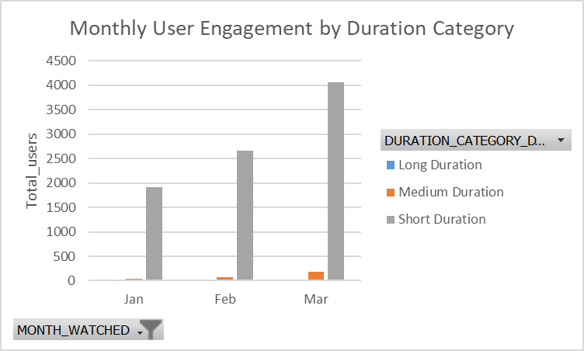
monthly Consumption Patterns by Channel and Duration
From January to March, Sports consistently attracts the highest viewership, while Special Events remains the least watched channel.
March records the most viewers overall, with 2,028 out of 4,248 users (~48%) watching Sports and only 30 users engaging with Special Events.
In contrast, January has the lowest overall viewership, with 600 out of 1,948 users (~31%) listening to Music and 35 users watching Movies.
These trends highlight that Sports is the dominant channel across the first quarter, whereas Special Events receives minimal engagement.
From January to March, short films dominate viewership, while long films receive minimal engagement.
March records the highest number of views, with 4,066 out of 4,248 users (~96%) watching short films and only 2 users engaging with long films.
January has the lowest overall viewership, with 1,907 out of 1,948 users (~98%) watching short films and no views recorded for long films.
This trend highlights a consistent preference for short-form content throughout the first quarter of the year.

Slide 11
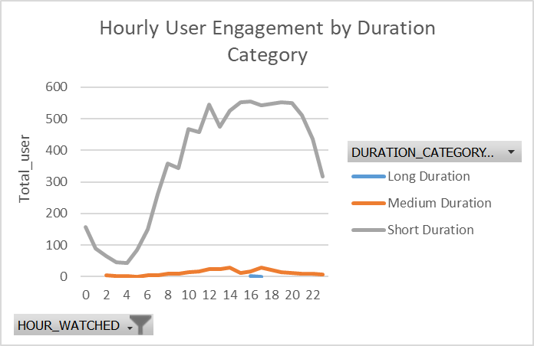
Hourly Consumption Patterns by Channel and Duration
Hourly viewership shows that short films dominate throughout the day, peaking at around 552 viewers between the 15th–20th hours and dipping to 43 viewers early in the day (0–4th hour).
Medium films fluctuate, rising from 4 viewers in the early hours to 30 viewers mid-day, dipping briefly, and then rising again.
Long films receive minimal engagement, with only 2 views between the 16th–17th hours.
Overall, short films attract the most consistent attention, while medium and long films see limited and variable viewership.

Slide 12
RECOMMENDATIONS
Consumption on Bright TV is shaped by several factors, including the relevance and appeal of the content, the convenience of viewing times, user demographics, seasonal trends, and how engaging or easy the platform is to use.
On days with low consumption, viewer activity can be boosted by introducing high-interest content such as sports recaps, trending short-form entertainment, themed movie blocks, exclusive previews, or interactive content that encourages users to log in more frequently.
To further expand Bright TV’s overall user base, the platform can implement initiatives such as targeted digital advertising, personalized recommendations based on viewing patterns, promotional bundles, referral rewards, community engagement campaigns, and partnerships with influencers or entertainment brands. These strategies not only attract new users but also strengthen engagement among existing viewers, gradually increasing usage and long-term subscription growth.

Slide 13
CONCLUSION
Overall, the analysis shows that Bright TV’s audience behavior is strongly influenced by content relevance, accessibility, and engagement value. Short-form content, sports programming, and high-interest entertainment consistently drive the highest consumption across demographics, days, and provinces. Increasing viewership on low-consumption days will require strategic content placement that aligns with audience preferences, while long-term growth will depend on targeted initiatives that enhance user experience, personalization, and platform visibility. By leveraging these insights, BrightTV is well positioned to improve daily consumption, strengthen user engagement, and expand its subscription base.

Slide 14
End of the presentation

